Slide 1
Lesson objective
Need whiteboards and calculators.
Title: Area and Perimeter
Aim:
Determine the perimeter of common shapes
Be able to substitute into formula when solving area of triangles
Plan:
Daily review
  Integers
Calculating perimeter
Substituting for area
PBiS focus: Achieve
- Ask and accept feedback to improve.

Slide 2
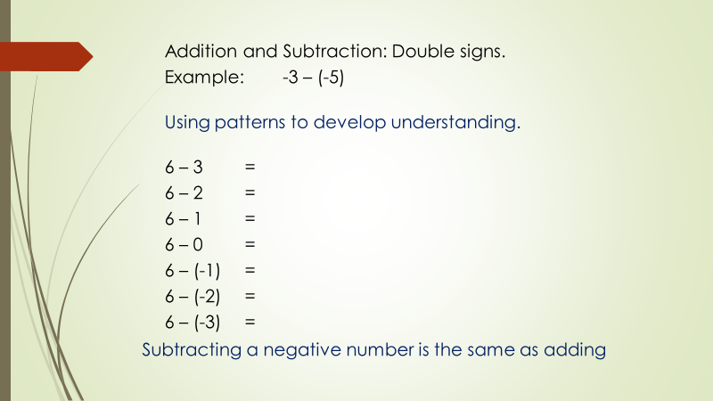

Slide 3
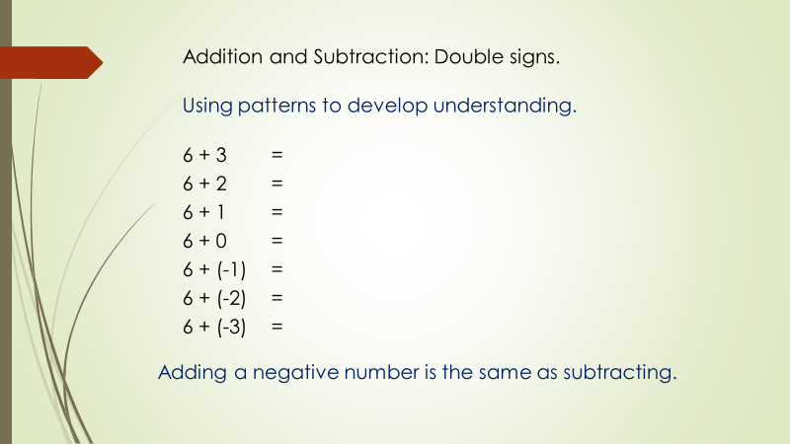

Slide 4
Addition and Subtraction: A number-line approach
To use the number line you need a starting point, a direction and a number of places to move.
Example: -3 – 5
Starting point
Number of places
Direction:
+ move right
– move left

Slide 5
Simplify double signs
Start/move/direction
3 + (-5) =
-3 + (-5) =
3 - (-5) =
-3 - (-5) =

Slide 6
9 + (-7) =
-9 + (-7) =
9 - (-7) =
-9 - (-7) =

Slide 7
Exercise books
5 + (-5) =
10 – (-3) =
9 + (-4) =
11 – (-5) =
8 + (-2) =
10 + (-6) =
44 + (-11) =
20 + (-17) =
4 + (-5) =
10 – (-23) =
15 – (-7) =
40 – (-33) =
-8 + (-10) =
-10 + (-23) =
19 + (-25) =
-13 – (-13) =
-50 – (-100) =
-35 – (-72) =

Slide 8
Perimeter
Perimeter is the distance formed by the boundary of the shape.
To calculate perimeter, we need to PLUS all the sides.
10cm
11cm

Slide 9
Complete
“What is hurling”
SUM fun 73

Slide 10
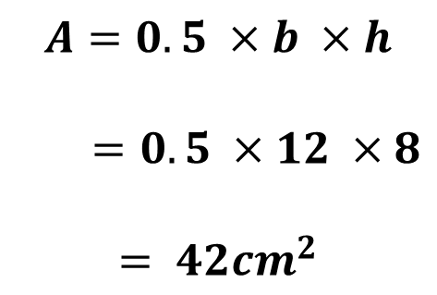
Area of triangles
Area is the total space within the perimeter.
Always remember
Diagram
Rule
Numbers
Solve
$$A=0.5 ×b ×h$$
$=0.5 ×12 ×8$
$$= {42cm}^{2}$$
8cm
12cm

Slide 11

Area of shapes.
Height and base must always be perpendicular.
Perpendicular means lines meet at $90°$

Slide 12
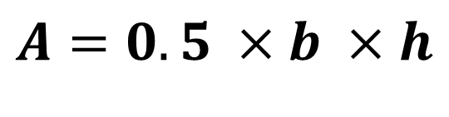
We do
Always remember
Diagram
Rule
Numbers
Solve
$$A=0.5 ×b ×h$$
3km
4km

Slide 13
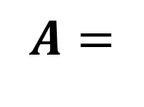
We do
Always remember
Diagram
Rule
Numbers
Solve
$$A=$$
12m
6m
10m

Slide 14
Whiteboards
Always remember
Diagram
Rule
Numbers
Solve
7m
11m

Slide 15
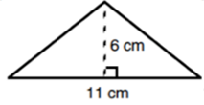
Whiteboards
Always remember
Diagram
Rule
Numbers
Solve

Slide 16
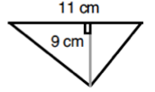
Whiteboards
Always remember
Diagram
Rule
Numbers
Solve

Slide 17
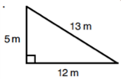
Whiteboards
Always remember
Diagram
Rule
Numbers
Solve

Slide 18
You do
Complete “How is a rifle like a lazy worker?”
Sum fun 77

Slide 19
Reflection – fist to 5
Aim:
Determine the perimeter of common shapes
Be able to substitute into formula when solving area of triangles

